Slide 1
Mobile & Web App Development Project Elixir Version 1.5 Modified 1st October, 2020

Slide 2
Why Mobile & Web App Development
Elixir is a web and Mobile application that will aid the student in their learning. The application is primarily focused on the students practicing the lessons through assessments
This is an initiative that would enable the youth to use technology in their learning process
A tool to bring in “Gamification” into the learning process
A tool to have some quantitative view of the progress of the student in the learning cycle
The Mobile and Web App is expected to be a complimentary tool and it is intended to be used along with the sessions

Slide 3
High Level Requirements - Background
Creating Futures would like to use mobile and web technologies to enhance the learning of the students.
Therefore, this Web & Mobile app is expected to compliment us in the training programs that we conduct.
This app will not be a standalone training module, but will be used alongside the programs we conduct
The Application will have 2 modules
Admin Module
Student Module

Slide 4
High Level Requirements – General
Students will be given a mobile or a tablet with the app installed
In the CF Center, the Web App will be installed in all the laptops
Students will use this app for the various modules that CF has
The app should be able to track the progress of each of the students
There should be three types of users. Admin, teacher and students
Admin user will upload the questions and answers
Should be able to get basic reports for teachers, admin and students
Admin and teachers can access through online
This Web and Mobile app should work on offline mode
Should be intuitive and simple to use for the students
One mobile device should be able to cater to multiple students
Should be able to sync back to the main server when connect to Internet

Slide 5
Roles
Roles | Responsibility
Admin | Responsible for the overall application Creates / Edits questions based on the levels. Maintains the master list of questions Works outside the session
Teacher | Who runs the session and will have few features to run the session
System | The application
Student | Students who take the sessions

Slide 6
Feature List
Sl.No | User | Feature | Possible | Phase
1 | General | Log in Screen for Admin (Basic Authentication) Web Based | Y | Phase 1
2 | General | Change Password for Admin Web Based | Y | Phase 1
3 | Admin | Maintained list of Questions based on Type of Questions Web Based | Y | Phase 1
4 | Admin | Upload of questions (web Based) Bulk | Y | Phase 1
5 | Admin | Manage Student details (Add & Edit) (web Based ) | Y | Phase 1
6 | Admin | Manage Facilitator details (Add & Edit) (web Based ) | Y | Phase 1
7 | Admin | Manage Program, Program Modules, Levels, Batch and Center details (Add & Edit) (web Based ) | Y | Phase 1
8 | System | Have Questions for a program / session | Y | Phase 2
9 | System | Synchronize answers / performance for each student after the session. Download into excel
10 | System | Refresh / Clearing of a session data
11 | System | Work offline

Slide 7
Feature List
Sl.No | User | Feature | Possible | Phase
12 | Students | Log into Program / Session | Y | Phase 2
13 | Students | Answer Questions | Y | Phase 2
14 | System | Display Results and the Correct answers | Y | Phase 2
15 | System | Goes to next level based on “Pass” results. (The number of levels will be based on the question bank and the complexity of the questions) | Y | Phase 2
16 | System | Ability to retake the test | Y | Phase 2
17 | System | There will be multiple type of Questions (detailed in later slides)
18 | System | Give Points / Rewards (Like a Game)
19 | Teacher | Able to register students during the session. Student Id to represent ProgramId->BatchId->StudentId
20 | Teacher | Ability to override some answers when there is a conflict (possible of having multiple correct answers)
21 | Admin | Download of questions (web Based) Bulk
22 | All | Relevant Reports for all type of users

Slide 8
Phase 1 - Admin Module

Slide 9
Admin User Functionality
Create
Read
Update
Sl.No | Functionality | Description | Operations
1 | Password | Create / Change Password for Facilitators and Students | C/U
2 | Program | These are the various Programs of Creating Futures | C/R/U
3 | Modules | For every Program, we will have multiple Modules | C/R/U
4 | Levels | For every Module, we will have multiple Levels | C/R/U
5 | Facilitators | These are the Volunteers of Creating Futures | C/R/U
6 | Batch | These are sessions that we conduct for a school / college / Community / Institute | C/R/U
7 | Students | Master Data of all the students | C/R/U
8 | Question | List of all Questions (There are 12 types of questions. The Screens will change based on the question) | C/R/U
9 | Reports | To be done later
10 | Home Page | List of Programs, Modules and Facilitators | View
11 | Partners | List of all our Partners (NGOs / Schools / Colleges, etc.) | C/R/U
12 | Students – Mass Upload | Mass upload of Student details from Excel Sheet | Upload
13 | Students – Download | Export to Excel Sheet | Download
14 | Questions – Mass Upload | Mass upload of Questions details from Excel Sheet | Upload

Slide 10
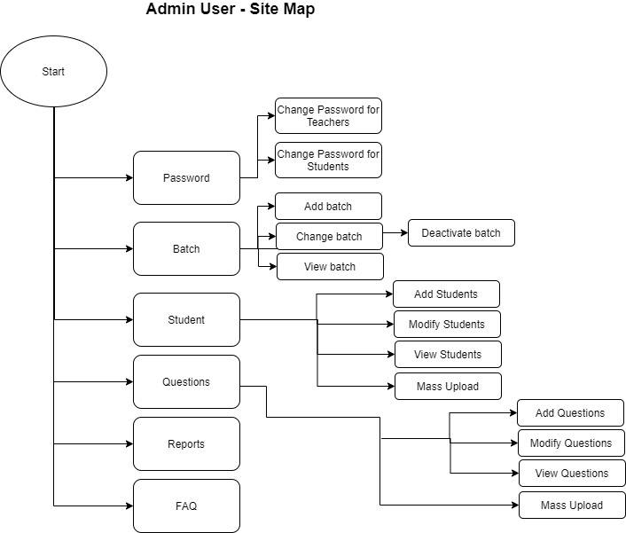
Admin User – Site Map
Need to have an option to add - Programs, Module and Facilitators

Slide 11
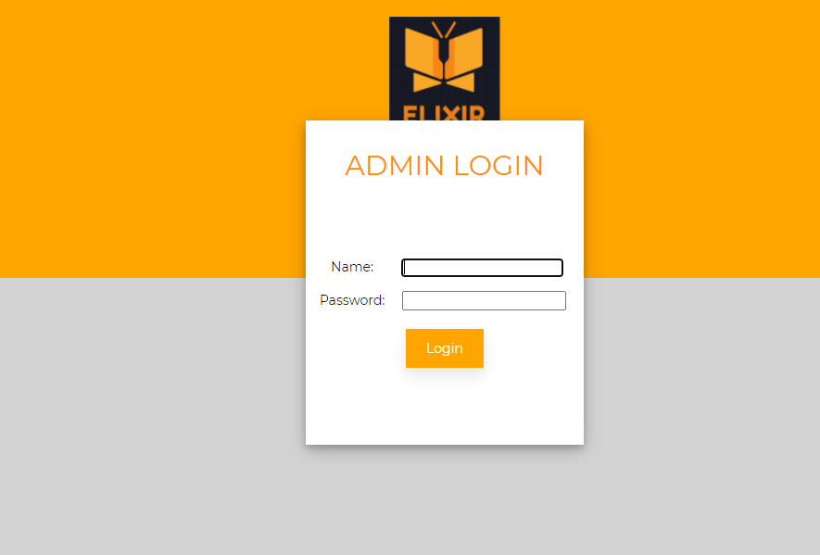
Admin – Login Page

Slide 12
Home Page
In the Home Page, there will be the following option
CRUD for Programs
CRUD for Modules (Modules are associated to a Program)
CRUD for Levels (Levels are associated for a Module).
For Levels, the screens are not in the Home Page, but in the subsequent pages
CRUD for Facilitators
PROGRAMS->MODULES->LEVELS
Prerequisites
For a Module to be entered, an existing Program should be entered in the DB
Similarly, for a Level to be entered, an existing Modules should be entered

Slide 13
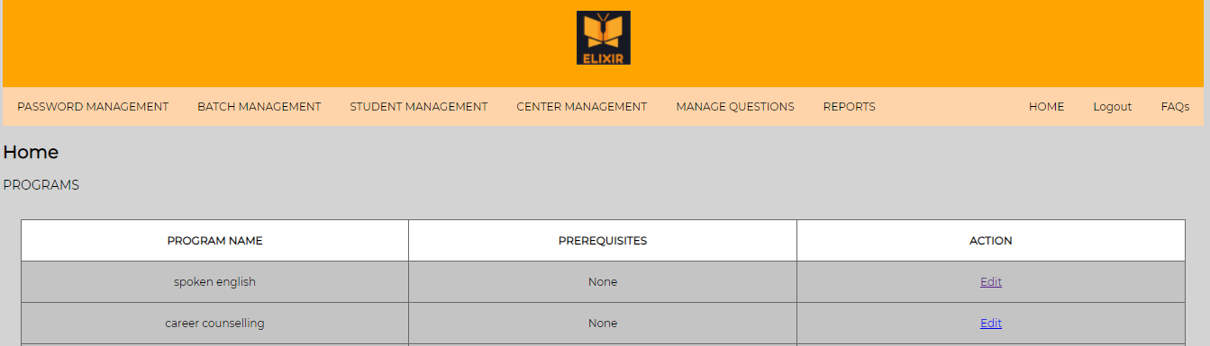
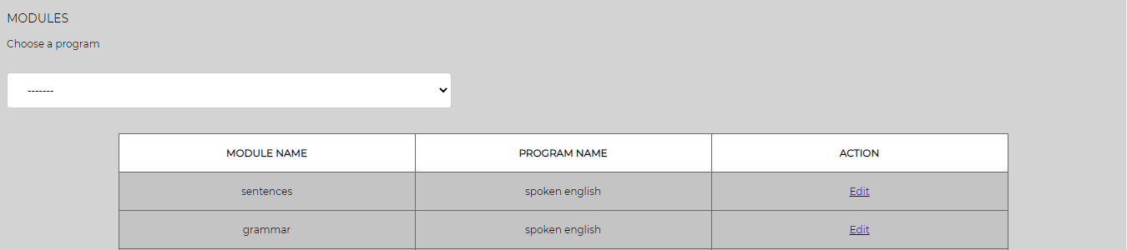
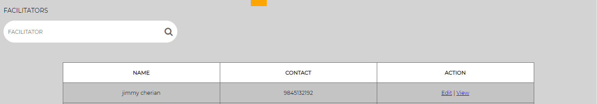
Admin – Home (after Login)

Slide 14
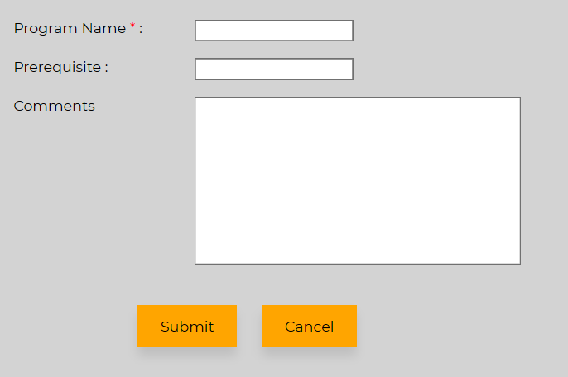
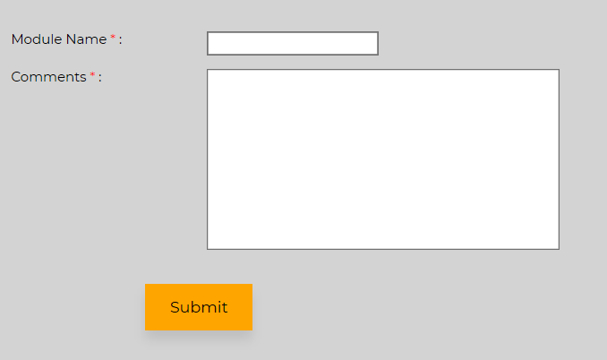
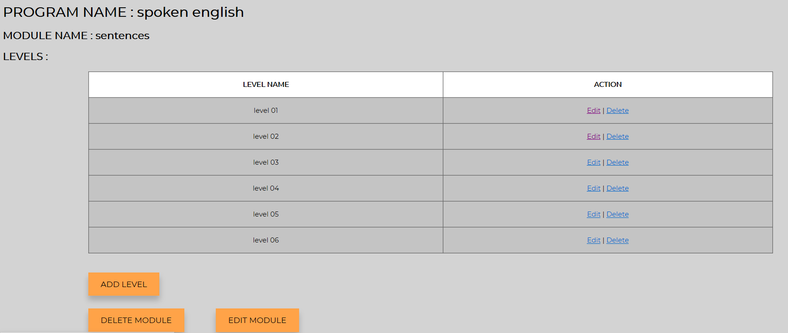
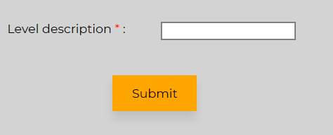
Program->Modules->Levels

Slide 15
Password Management
Password can be changed for
Facilitators
Students
As a pre-requisite, Facilitators and Students should be entered in the DB
When creating a Facilitator, a default password is assigned
Only those users will Admin access can change the Password for both Facilitators and Students

Slide 16
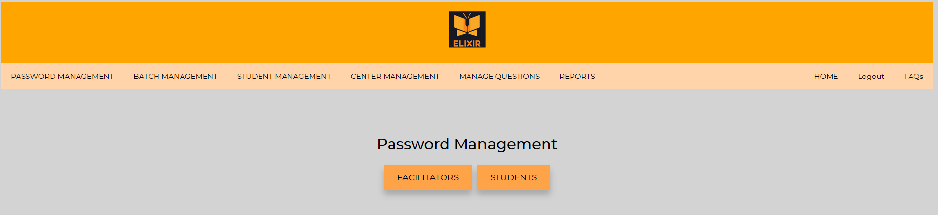
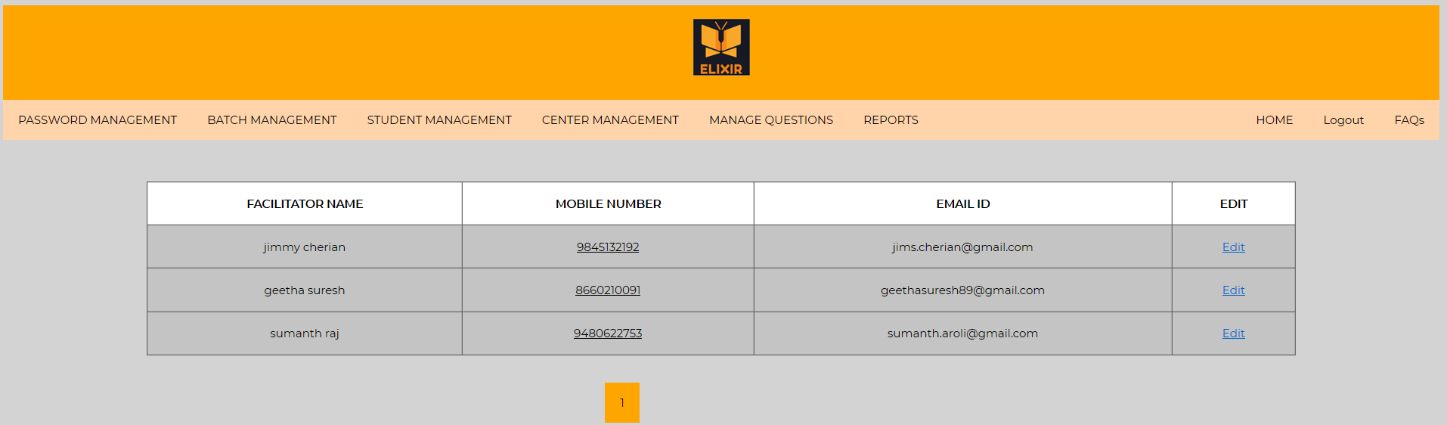
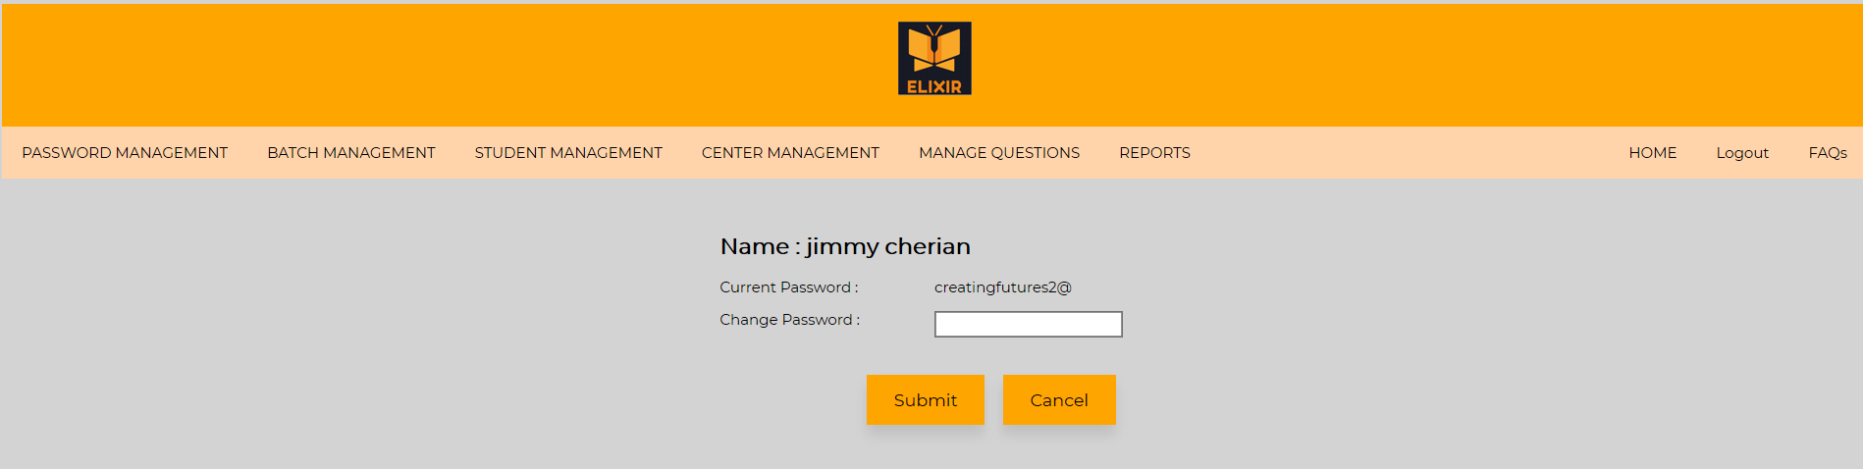
Password Management

Slide 17
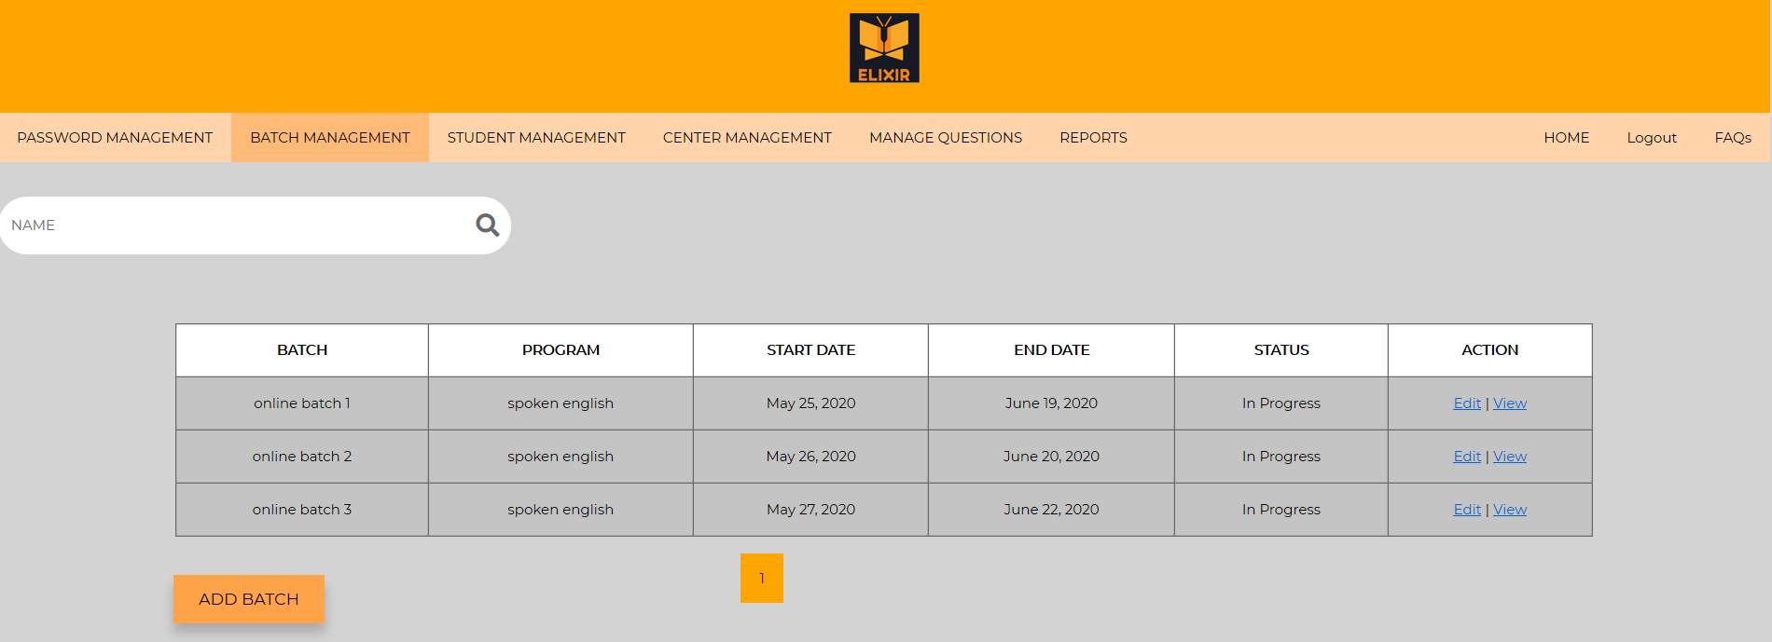
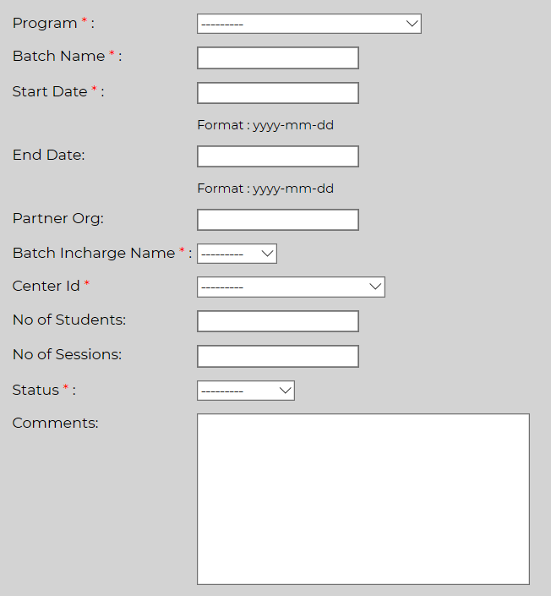
Batch
A “Batch” is a program with a start and end date.
A “Batch” can be created / edited / read
A Search functionality is also given to search for a particular batch
The following should be in the DB, before a batch is created
Program
Facilitator (Batch In-charge)
Center

Slide 18
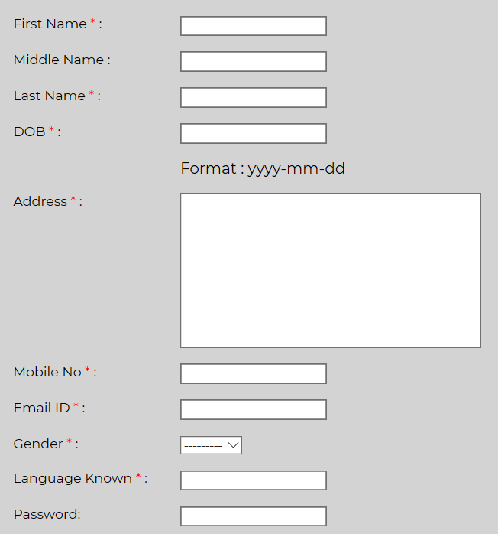
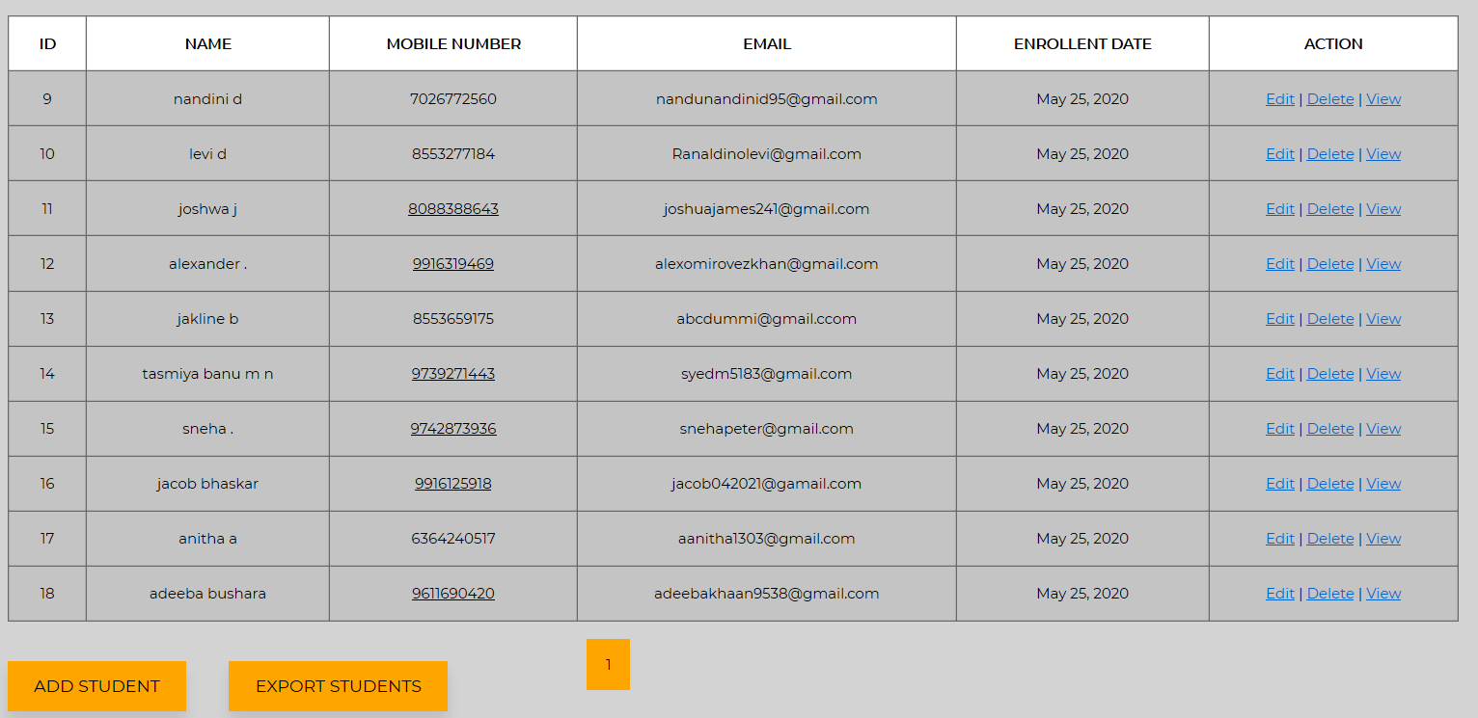
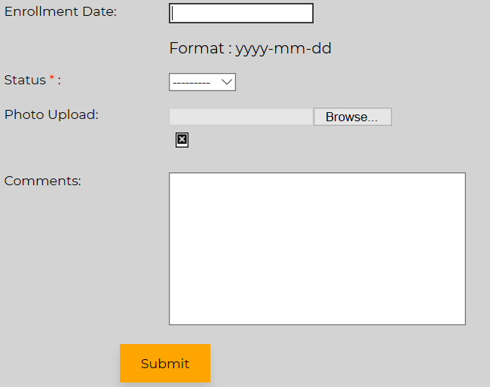
Students
Creates / Updates / Deletes and Reads all the students of Creating Futures
A Search functionality is also given to search for a particular batch

Slide 19
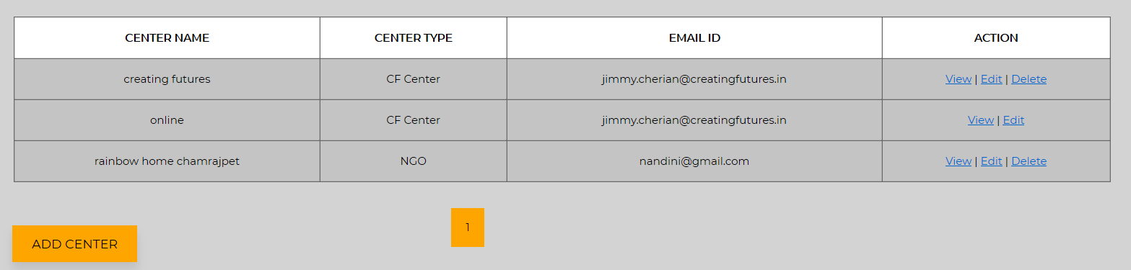
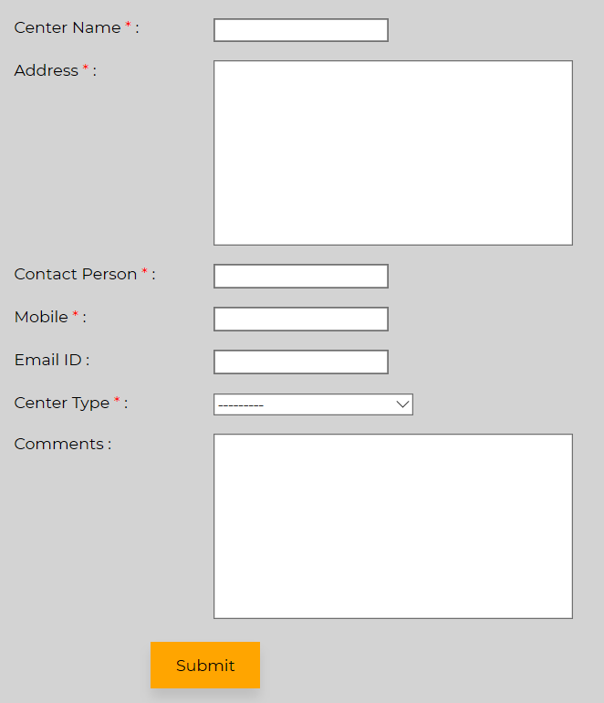
Center / Partner
Creates / Updates / Deletes and Reads all the Partners (or Centers) of Creating Futures
Center can be of the following
School
College
CF Center
Community Center
NGO
Skill Developmentary Center

Slide 20
Questions
Questions will be for a Program -> Module -> Level
Spoken English -> Words -> Level0 -> Questions
Each Level will have a set of Questions
To move to next level each student should finish all questions in each level
Score assessment will be done for each level
All of these will be Objective based questions
Apart from the above, there will be some subjective based questions – for the following modules
Writing
Conversation
Question Types
Multiple Choice
Fill in the blanks
Scramble & Unscramble
Riddles
Match the following
Word Search
Crosswords
Single Image based Questions
Multiple image Questions
Audio based questions
Video based questions
Text based questions

Slide 21
Logic for Question Types
Multiple Choice – The user should be able to add a question and a maximum of 4 options
Fill in the blanks - The user should be able to add a question and one answer
Scramble & Unscramble - The user should be able to add a question and one answer
Riddles - The user should be able to add a question and one answer
Match the following – For this type of question, there will be set of questions in the left, with answers / options on the right. The uses will have to map the left and right side
Word Search – Words will be hidden in a haze, with clues given for the users. Based on the clues, the user would need to find the corresponding words
Crosswords – Boxes are arranged vertically (down) and horizontally (across), with clues given for the users. Based on the clues, the user would need to find the corresponding words
Single Image based Questions - The user should be able to add an image as a question and a maximum of 4 options as text
Multiple image Questions - The user should be able to add a text as a question and a maximum of 4 options as images
Audio based questions - The user should be able to add an audio file as a question and a maximum of 4 options as text
Video based questions - The user should be able to add a video file as a question and a maximum of 4 options as text
Text based questions - The user should be able to add a text file as a question and a maximum of 4 options as text

Slide 22
Spoken English – Module & Question Mapping
Module | Multiple Choice | Fill in the blanks | Unscramble | Riddles | Match the following | Word Search | Crosswords | Image based | Audio | Video | Text
WORDS | X | X | X |  | X | X | X | X
SENTENCES | X | X | X | X | X | X | X | X
GRAMMAR | X | X | X | X | X | X | X | X
QUESTIONS | X | X |  |  |  |  |  | X
LISTENING |  |  |  |  |  |  |  |  | X | X
WRITING |  |  |  |  |  |  |  |  | X | X | X
READING |  |  |  |  |  |  |  |  |  |  | X
CONVERSATIO |  |  |  |  |  |  |  |  |  |  | X

Slide 23
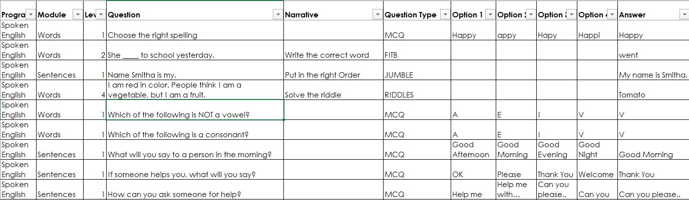
Type of Questions - Examples

Slide 24
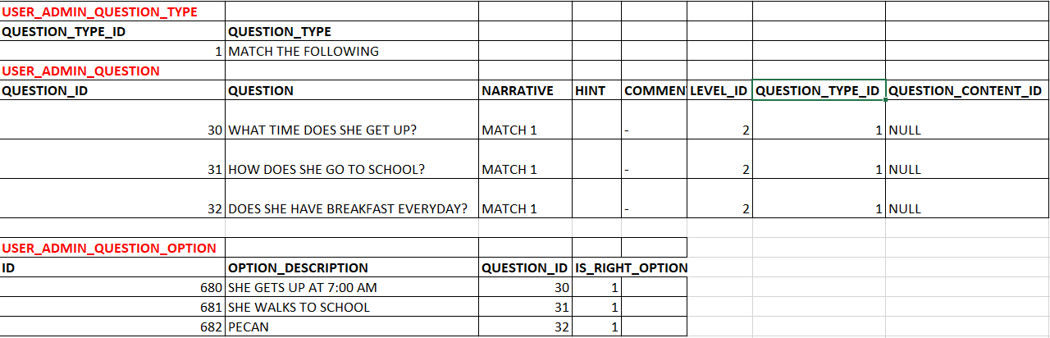
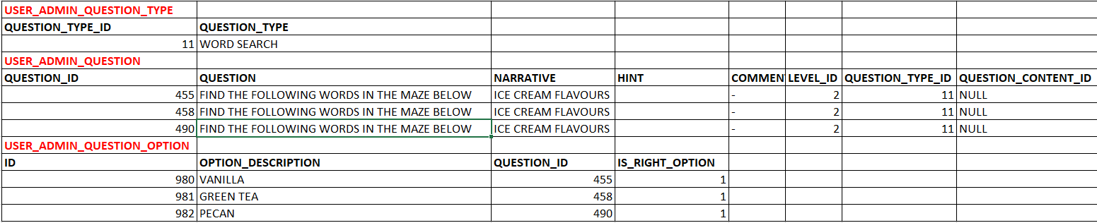
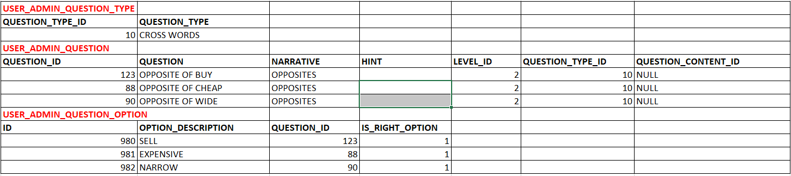
Type of Questions – Examples for Match the Following, Word Search and Crossword
Match the Following
Word Search
Crossword

Slide 25
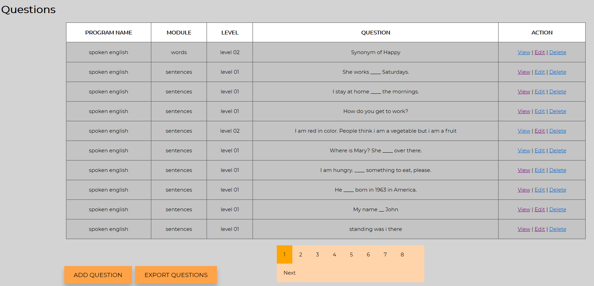
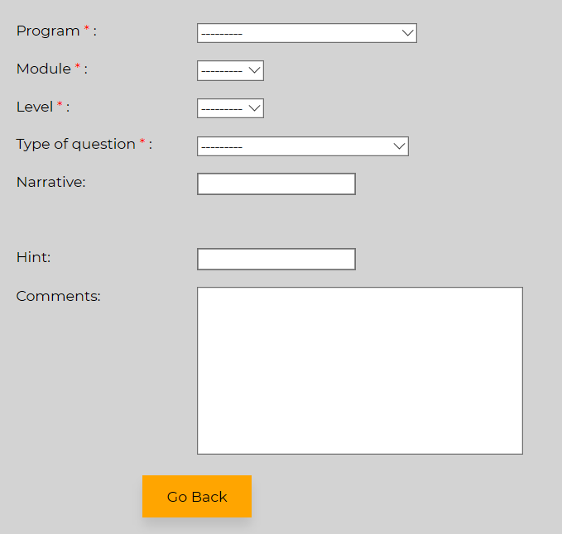
Screens for Questions
Creates / Updates / Deletes and Reads all Questions
Option to download the questions into excel sheet
Option to bulk Upload the questions from an excel sheet
Option to filter and search for a Question
Pre-requisites for adding questions are the following
Program
Module
Level
Type of Questions

Slide 26
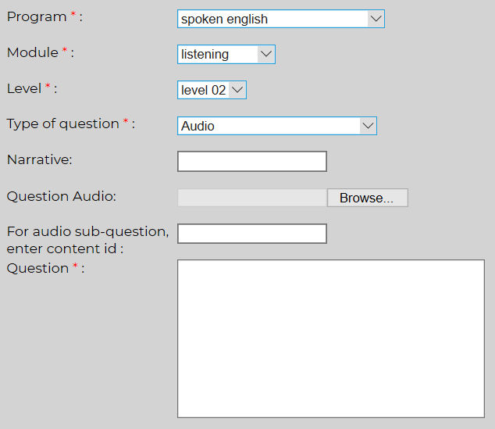
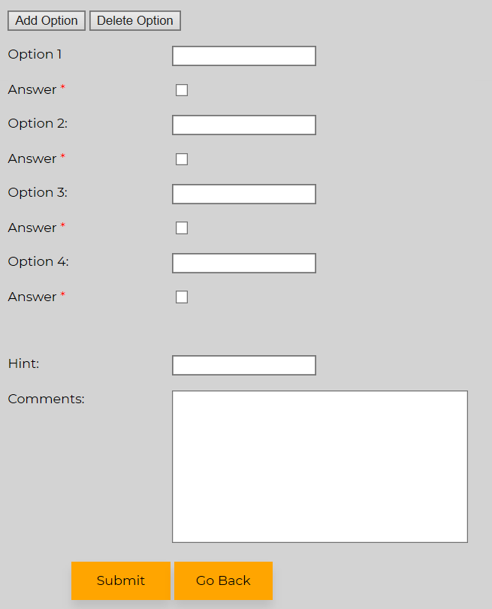
Screens for Questions
For the following type of Questions, the files will be stored in the server. Therefore, only the file path will be stored in the DB.
Also, for the below type of Questions, for each “File”, there will be multiple questions associated with the “File”
Audio
Video
Text

Slide 27
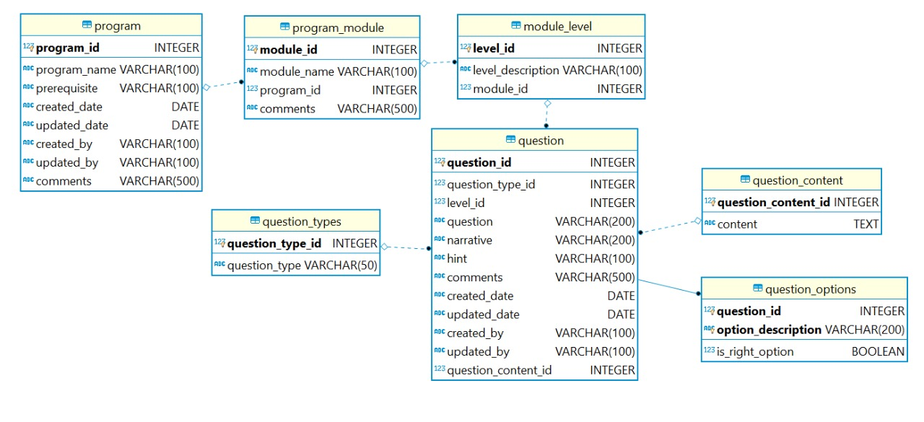
DB Design for Questions

Slide 28
Data Relations
Batch
Program
Facilitators
Center
Students
Modules
Not all programs should have modules
Levels
Legends
Master data
Questions
Created using master data

Slide 29

DB Design
DB Design Attached
Sheet 1 – has sample data
Sheet 2 – Data attributes

Slide 30
Student Module

Slide 31
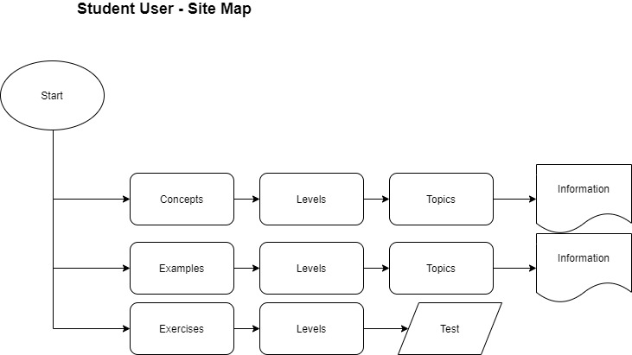
Student User – Site Map

Slide 32
Student user
Functionality
Login Screen
Home Page for Students
1st time user will have generic instructions
Repeat User will have the status of where they are
Home Page will have all the Programs
The Programs will have a short summary
On clicking on the particular Program, Students will be shown all the modules and levels for the selected programs.
Students should go from one level to another for each of the modules
The Scores will be shown at the “Level” and summarized into the “Modules” and then, at the “Program”

Slide 33
Student user – Taking the Assessment
For each level, there will be a random set of 20 questions shown to the student (General Assessment)
Following are the types of assessment
General Assessment. This includes “Multiple Type Questions” , “Riddles”, “Fill in the blanks”, “Scramble”, “Single Image” “Multiple Image”
Match the Following
Word Search
Crossword
Audio
Video
Text
For General Assessment
One question will be displayed at a time
The students answers that question till (s)he gets it right
Then, the next question will be displayed
Points are received only when the student answers in the 1st attempt
If the student gets 16 or more questions correct in the 1st try, then (s)he goes to the next level
Spoken English

Slide 34
Student user – Taking the Assessment
Match the following
For all match the following questions, under any level of spoken English module, the program should get all the questions and answers from the database and show it in the format as described in the UI.
For a Module -> Level,
List all of the “Match the Following” Questions
These should be listed as Hyper Links
On clicking on a particular question, the Problem will be displayed
For that particular Match the Following, the program should fetch all the Left and Right parameters for display
Once the user enters the data, these should be validated for correct answers
If the answers are not correct, highlight in red and ensure screen stays in the same page
If the answers are correct, highlight it in green and given option to take another Match the Following Question or to go back
Validation should be done to ensure that all entries are made
Spoken English

Slide 35
Student user – Taking the Assessment
Crosswords
For all Crossword questions, under any level of spoken English module, the program should get all the questions and answers from the database and show it in the format as described in the UI.
For a Module -> Level,
List all of the “Crossword” Questions
These should be listed as Hyper Links
On clicking on a particular question, the Problem will be displayed
For that particular Crossword, the pattern will be shown (as in the UI) with ‘across’ and “down” questions mentioned below the pattern.
Once the user enters all the data, these should be validated for correct answers
If the answers are not correct, highlight in red and ensure screen stays in the same page
If the answers are correct, highlight it in green and given option to take another Crossword or to go back
Validation should be done to ensure that all entries are made
Spoken English

Slide 36
Student user – Taking the Assessment
Word Search
For all Word Search questions, under any level of spoken English module, the program should get all the questions and answers from the database and show it in the format as described in the UI.
For a Module -> Level,
List all of the “Word Search” Questions
These should be listed as Hyper Links
On clicking on a particular question, the Problem will be displayed
For that particular Word Search, the pattern will be shown (as in the UI) with words to be searched mentioned below
Once the user enters all the data, these should be validated for correct answers
If the answers are not correct, highlight in red and ensure screen stays in the same page
If the answers are correct, highlight it in green and given option to take another word search or to go back
Validation should be done to ensure that all entries are made
Spoken English

Slide 37
Scoring
Scores for any student talking a test must be stored at the end of the assessment. One mark is obtained for each correct answer. There is no negative marking for wrong answers.
Answering 80% of the questions under a level correctly will enable going to the next level (Currently, a student is allowed to take assessments under any level).
Scoring Logic can be categorized into the following
General Assessment.
For this, each time, the student takes a test, an entry in made in the database. Any result >= 80% is PASS.
If the student is not completing the test, still the record is created with FAIL
AV & Text based
Under this, the scoring is against each AV & Text Questions. (do note that there will be multiple sub-questions for a Question)
If the student scores >= 80%, then that Question is marked as PASS and the record stored.
Data should be stored to show the type of Question (Audio / Video / Text) and the Question Content ID
Gamification (Match the Following / Crossword / Word Search)
Here, the result will either be PASS or FAIL.
Data should be stored to show the type of Question (Match the Following / Word Search / Crossword) and the Question Content ID

Slide 38
Scoring
Display of Scores
The Scores will be displayed to both Students and Teachers
For Students, the Scores will be shown at the Program level and this will be further drilled down to the Module Level and for a particular Level
When the Student logins in, the student will be able to see only his scores
For Teachers, the scores will be show in the “Report” Section in the ADMIN module. The teacher will be able to see the scores for a batch or for a Student.
A Batch will show the scored of all the students associated with the Batch.
The Scores for the student will be shown at an aggregate level (Program Level) and there should be an option to drill down to Module and Level

Slide 39
High Level Requirements – E2E Program
The E2E will have the following modules
Aptitude Test
Logical Reasoning
Resume Builder
Logic for Aptitude Test and Logical Reasoning:
The students would log in
They would get a random number of questions. 20 questions.
The students answer these and submit
On click of submit, the app will give the student the results and the answers
This set of 20 questions will be randomly displayed each time the student takes the test.
Students need to log in with a username and password.
Scores are recorded for each assessment taken by the student
Following types of questions are applicable
Multiple Choice Question
Fill in the Blanks
Single Image

Slide 40
High Level Requirements – E2E Program
Logic for Resume Builder:
A template will be provided for the students to write their resume
Basic Validation will be done to ensure completeness
For all relevant fields, there will be a “balloon” help to guide the students
Option to preview and to download the resume will be provided

Slide 41
Student user – Taking the Assessment for Computer Coaching
A page for the “Computer Skills” program must be designed
The page should be similar to what has been done for Spoken English and Education to Employability
It should list the modules that exist for the computer skills program, together with the various levels for the module
It should allow students to take the following types of tests for each level
Multiple Choice Question
Fill in the Blanks
Single Image
Prerequisites
Modules and Levels to be added via user admin

Slide 42
Mock-Ups: Student – Login Screen

